Slide 1
Machine Learning Project Group 5
Nirja Shah
Tarun Ramapuram
Prajna Bangalore Rajeeva

Slide 2
Dataset Selection Process
Dataset Description:
It is collection of data of Mall Customers.
It contains 5 Attributes
1. CustomerID
2. Gender
3. Age
4. Annual Income
5. Spending Score
Where Annual Income and Spending Score tells about how customers spends at the mall, based on the certain income the spending depends.
Gender is the gender of the customer and age is the age they entered.

Slide 3
Selecting the mall customers dataset for clustering purposes can be advantageous due to several reasons.
The selection of the mall customers dataset for clustering purposes is driven by its richness of customer behavior data, business relevance, potential for exploratory data analysis, and its status as a commonly used benchmark dataset in clustering research.
These factors make it a valuable resource for studying customer segmentation and behavior analysis in retail and marketing contexts.

Slide 4
K Means
K-means clustering is a popular unsupervised machine learning algorithm used for partitioning a dataset into a predetermined number of clusters. It aims to group similar data points together while keeping them as separate as possible from data points in other clusters. k-means clustering is widely used for its simplicity, efficiency, and effectiveness in partitioning datasets into clusters, making it a versatile tool for various clustering tasks in machine learning and data analysis.

Slide 5
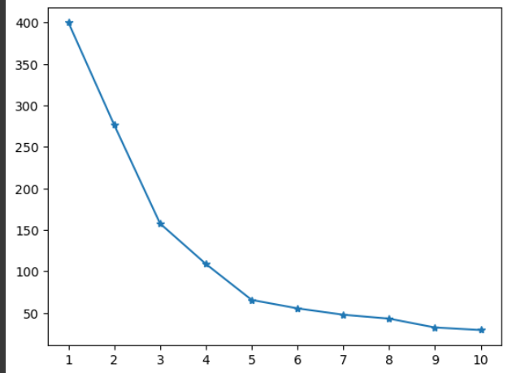
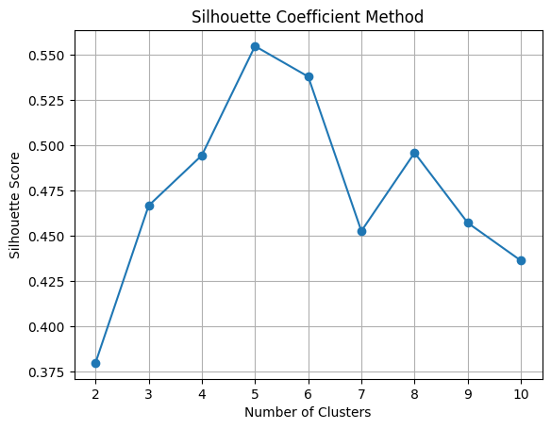
Process of determining optimal parameters
For K means: We are using the Elbow method and the Silhouette Coefficient Method

Slide 6
Based on the provided line plot, commonly known as an elbow plot, we can observe a significant change in the slope of the curve at k = 5. The plot represents the within-cluster sum of squares (WCSS) or inertia for different values of k in a k-means clustering algorithm.
Based on the silhouette coefficient method, selecting the number of clusters (k) where the silhouette score is highest is often considered optimal.based on the silhouette coefficient method, selecting k = 5 appears to be a reasonable choice as it corresponds to the point of highest silhouette score, indicating optimal cluster separation and cohesion.

Slide 7
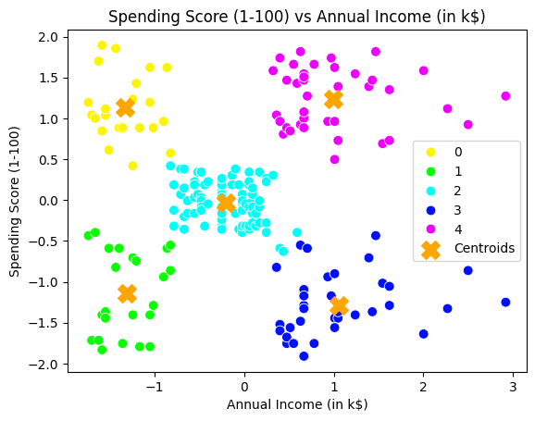
Results of the clustering analysis
This is the result of our K Means clustering process:
The data points are grouped into 5 clusters represented by different colors. Each color represents a different cluster.
The orange crosses represent the centroids of each cluster, which are the mean coordinates of the data points within each cluster.
Customers with similar annual income and spending scores are grouped together into clusters.

Slide 8
DBSCAN
Density-Based Spatial Clustering of Applications with Noise (DBSCAN) is a popular unsupervised machine learning algorithm used for clustering spatial data based on density. Unlike k-means, DBSCAN does not require the user to specify the number of clusters beforehand and can identify clusters of arbitrary shapes. DBSCAN is a powerful clustering algorithm suitable for various applications, especially when dealing with spatial data with complex structures and noise. However, careful parameter tuning and understanding of the dataset characteristics are crucial for its effective application.

Slide 9
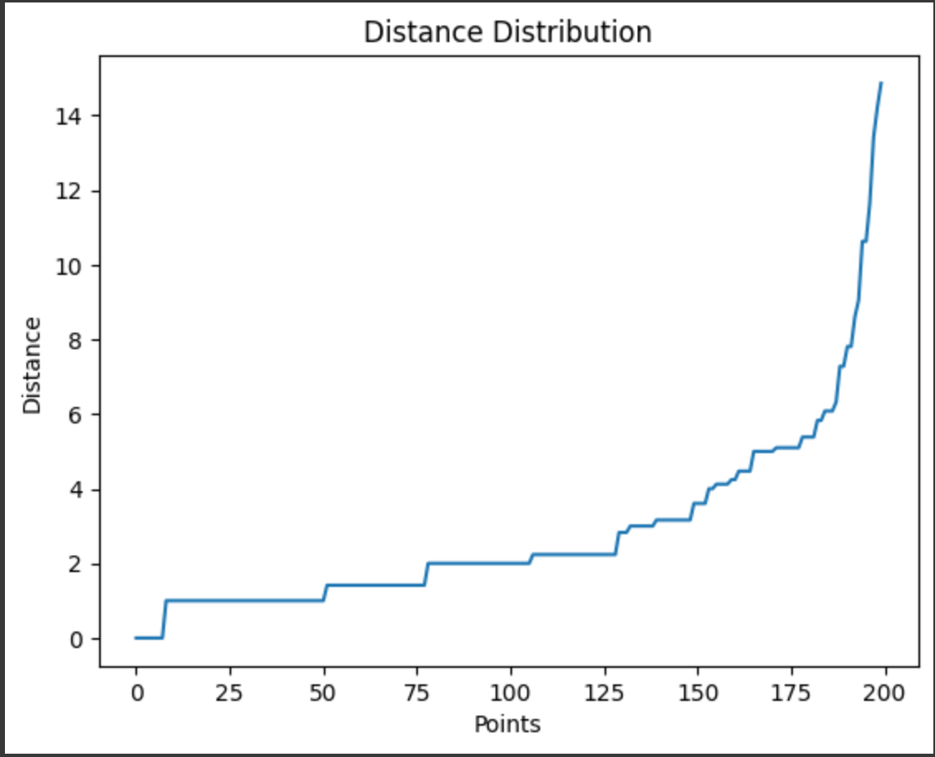
For DBSCAN we use the Elbow method for selecting Epsilon value and Min_Samples through visual inspection and trial and error method
In the context of DBSCAN (Density-Based Spatial Clustering of Applications with Noise), the choice of epsilon (ε) and min_samples parameters significantly influences the clustering results.
We arrived at the values of epsilon = 12 and min_samples = 9 based on the provided distance distribution graph and through visual inspection and trial and error.

Slide 10
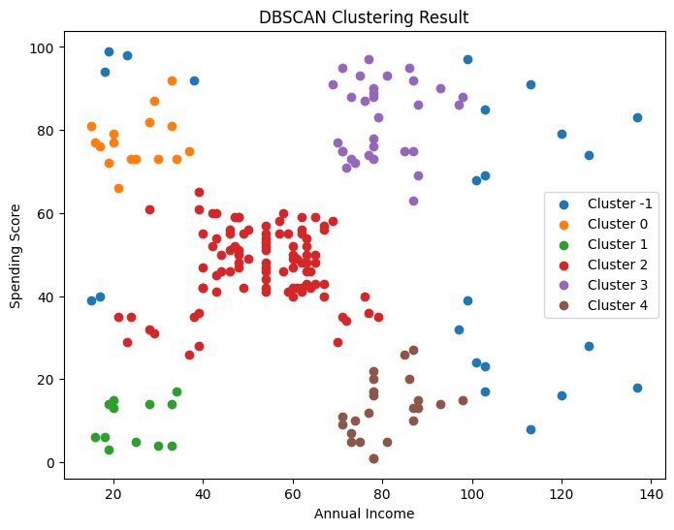
This is the result of our DBSCAN clustering process:
From our Elbow graph we decided that Epsilon value is 12 and Min_Samples is 9
The scatter plot depicts the clustering result, where each data point is represented by a colored dot.
The data points are grouped into clusters, each denoted by a different color.
In addition to the colored clusters, there is also a separate cluster labeled as "-1", which represents noise or outliers according to the DBSCAN algorithm.

Slide 11
Gaussian Mixture
Gaussian Mixture Models (GMMs) are probabilistic models used for clustering and density estimation tasks. Unlike K-means, which assumes spherical clusters, GMMs are more flexible as they model clusters as ellipsoids in the feature space. Gaussian Mixture Models are powerful tools for clustering and density estimation tasks, especially when the underlying data distribution is complex or multimodal. They offer a probabilistic framework for understanding the structure of the data and are widely used in various fields such as pattern recognition, image processing, and bioinformatics.

Slide 12
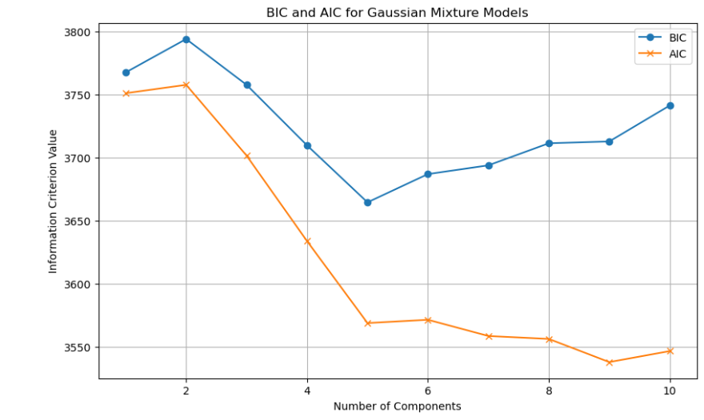
For Gaussian Mixture Model to find the optimal k value. There are two methods
Bayesian Information Criterion (BIC)
Akaike Information Criterion (AIC)
From BIC and AIC, The BIC has the least value at 5 and AIC has the least value at 9
Choosing the value of BIC which is 5 because the majority optimal algorithm methods such as Elbow and Silhouette Methods are giving the optimal value of 5.

Slide 13
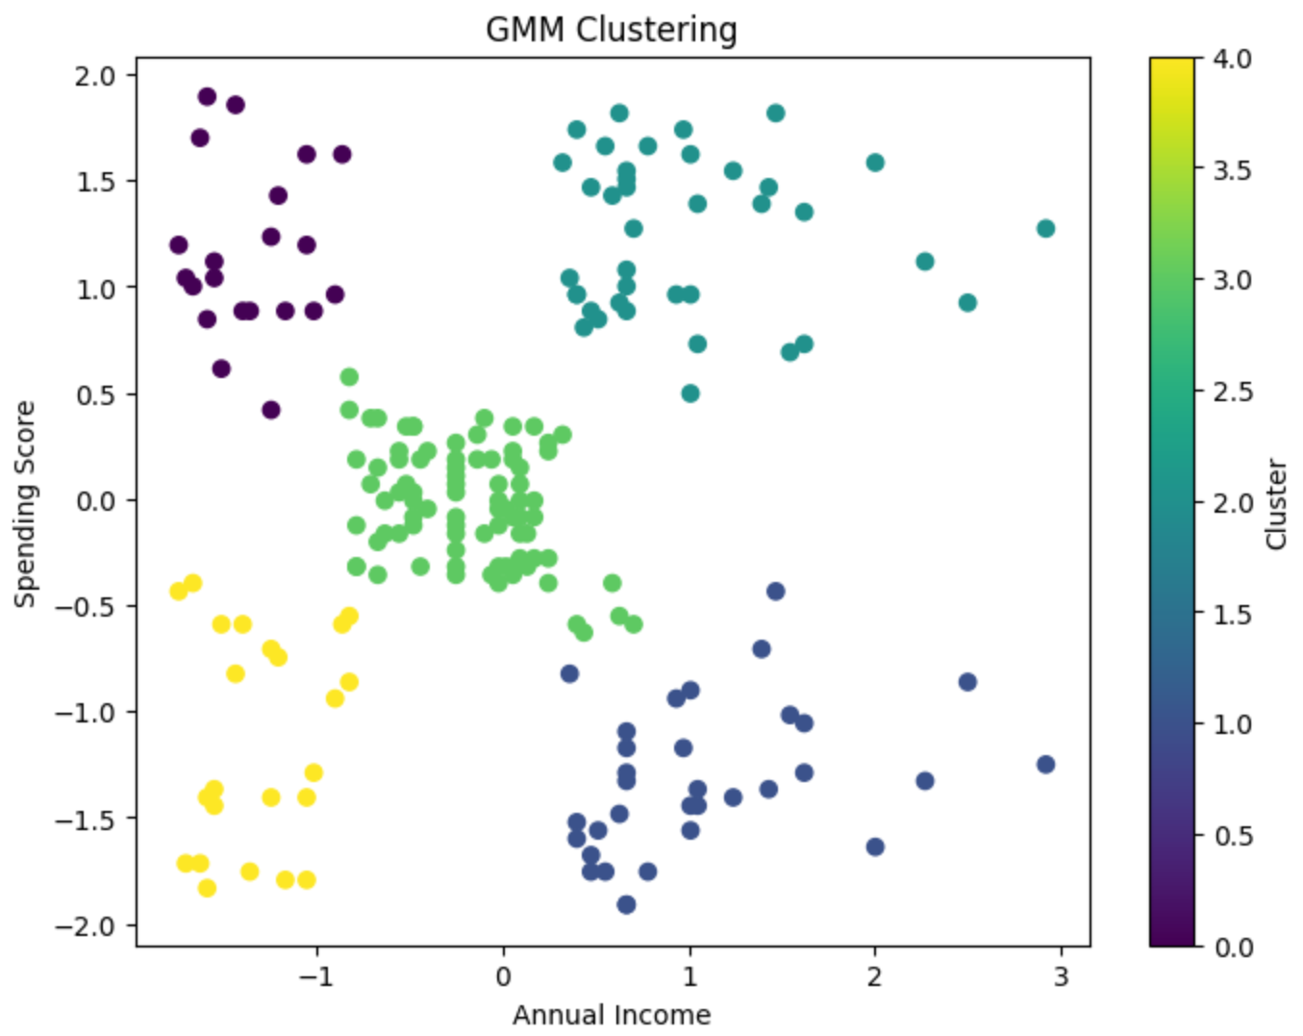
This is the result of our Gaussian Mixture Model clustering process:
From the BIC and AIC graph, we found the optimal value as 5.
It resembles the same clustering pattern as K Means in the Gaussian Mixture Model
Chosen 5 Components for the model which means there are 5 Gaussian Distribution Clusters.
Also, We can find Anomalies with the GMM Model using the Percentile.

Slide 14
Isolation Forest
for Anomaly Detection
Isolation Forest is an anomaly detection method that identifies outliers by isolating them into separate groups. It works by randomly picking features and splitting data points along those characteristics, resulting in partitions that isolate anomalies with fewer splits. Anomalies are identified as cases that take fewer splits to isolate, showing that they differ from regular data. Isolation Forest is effective for complex data and does not need the computation of distance measurements.

Slide 15
For Isolation or Anomaly detection we have used trial and error
For selecting the optimal contamination for Isolation Forest, we employed a trial-and-error approach. We experimented with contamination values ranging from 0.01 to 0.1 and observed the performance of the model with each value. After thorough testing, we found that a contamination value of 0.1 provided the best results with our dataset. This value struck a balance between capturing anomalies effectively and minimizing false positives.

Slide 16
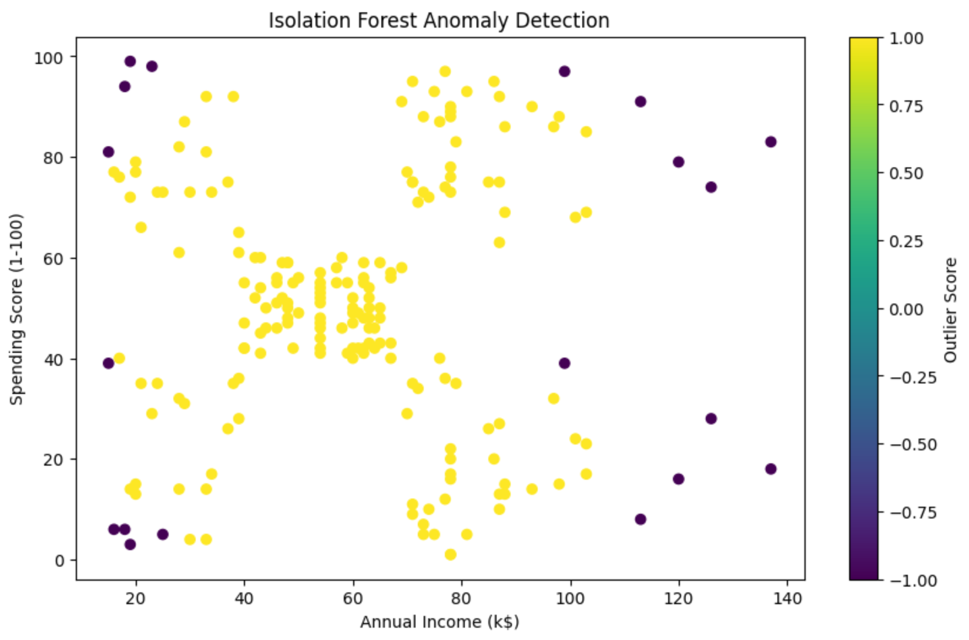
This is the result of our Isolation Forest for anomaly detection process:
From trial and error we found that 0.1 was the optimal value for contamination, which means that approximately 10% of the data points are expected to be outliers.
The purple dots represent anomalies detected by the Isolation Forest algorithm.

Slide 17
Insights gained
By analyzing the clusters, businesses can identify high-value customers who spend more and have higher income levels. This information can be used to target marketing campaigns and personalized offers to these segments.
Techniques like DBSCAN helped in identifying outliers or noise points in the dataset. These outliers may represent unique customer behaviors or data errors that need further investigation.
Clustering enables businesses to understand different customer preferences and tailor their products or services accordingly

Slide 18
Challenges encountered
Determining Optimal Parameters: One of the main challenges was determining the optimal parameters for each clustering algorithm, such as the number of clusters (K) for K-means or the epsilon value for DBSCAN. This often required experimentation and tuning, which can be time-consuming.
Dealing with Noisy Data: Clustering algorithms may struggle with noisy or ambiguous data, leading to suboptimal clustering results. Preprocessing techniques such as data cleaning and normalization are essential to mitigate this challenge.
Understanding the characteristics of each cluster and translating them into actionable insights requires domain knowledge and careful analysis.

Slide 19
Recommendations for future work
DBSCAN is robust to outliers, as it identifies clusters based on density rather than distance. However, for K-means and Gaussian mixture models, it's beneficial to remove outliers before creating and fitting the models to ensure well-formed clusters. Outliers can distort the centroids or means of clusters, leading to less accurate clustering results. Therefore, preprocessing steps such as outlier removal are often applied before applying K-means or Gaussian mixture models to the data.

Slide 20
Week - 3
Explainable AI

Slide 21
SHAP - Shapley Additive Explanations
INTRODUCTION TO SHAP
Definition: Shapley Additive Explanations (SHAP) is a method for explaining the output of machine learning models. It provides insights into how the input features contribute to the model's predictions.
Significance: In the context of machine learning interpretability, SHAP plays a crucial role in understanding complex models. It helps users comprehend why a model made a specific prediction, which is essential for trust and accountability in AI systems.
Explanation: SHAP values quantify the impact of each feature on the model's output. They provide a clear understanding of the contribution of each feature to the final prediction, enabling users to interpret model decisions more effectively.
Calculation: SHAP values are calculated based on game theory principles, specifically the Shapley value, which assigns a value to each feature by considering its contribution in all possible combinations with other features.

Slide 22
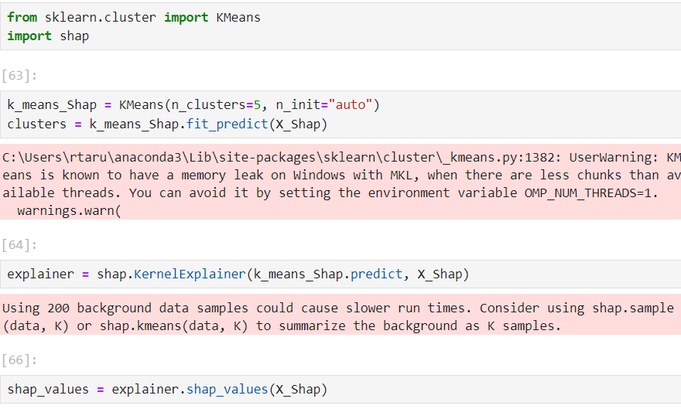
SHAP Python
Using the command !pip install shap. we can install the package of SHAP to the environment.
Before Implementing the SHAP we need to train the model.
We have used K means Algorithm to Train the Data as it is an Unsupervised Problem
SHAP has different Models in the SHAP Package, We are using shap.KernelExplainer which does not assume anything regarding the model. So can be applied for the Unsupervised Learning Model.

Slide 23
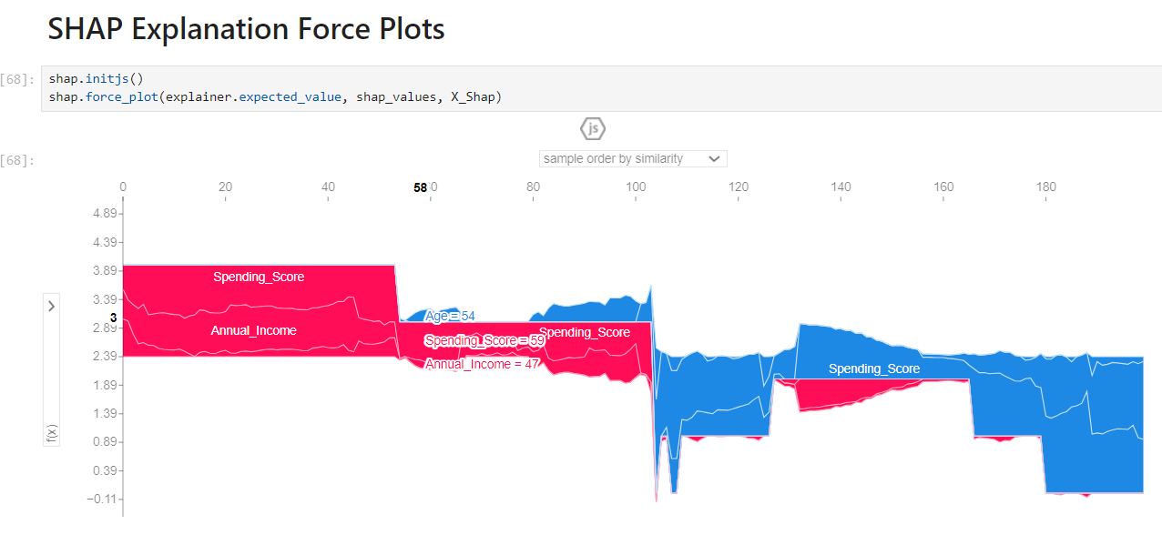
SHAP Results

Slide 24
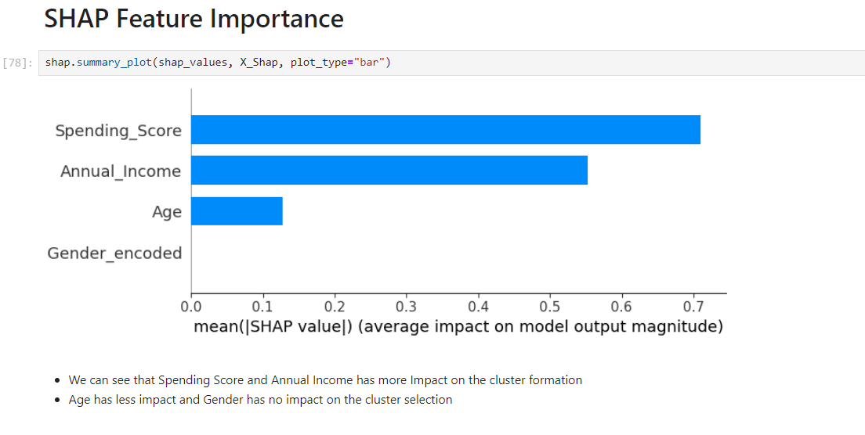
SHAP Results Continued

Slide 25
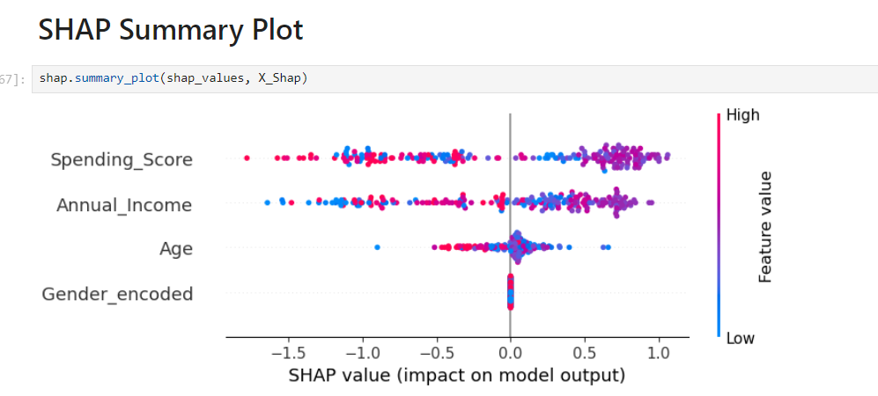
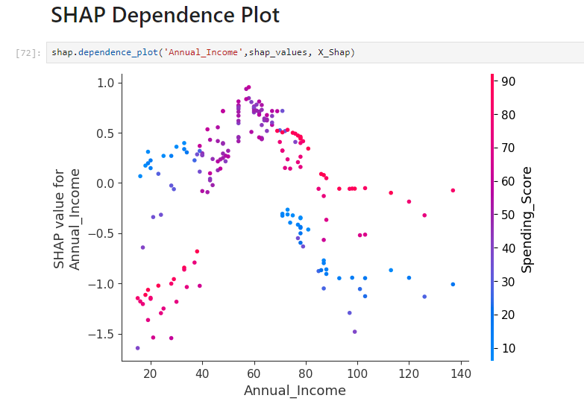
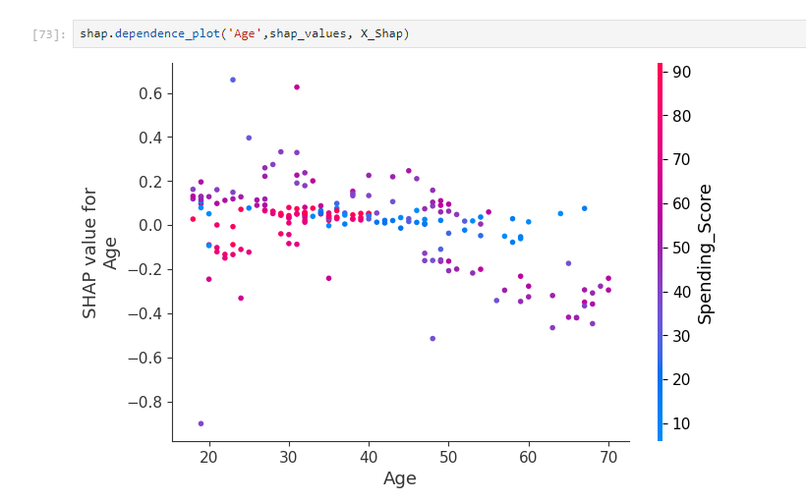
SHAP Results Continued

Slide 26
Dimensionality Reduction
Principal Component Analysis (PCA) and t-Distributed Stochastic Neighbor Embedding (t-SNE) are dimensionality reduction techniques commonly used for visualizing high-dimensional data in a lower-dimensional space.
PCA: Principal Component Analysis is a linear dimensionality reduction technique that preserves the most important information by capturing the directions of maximum variance.
t-SNE: t-Distributed Stochastic Neighbor Embedding is a nonlinear dimensionality reduction technique that focuses on preserving the local structure of the data in a lower-dimensional space, making it effective for visualizing clusters and identifying patterns.

Slide 27
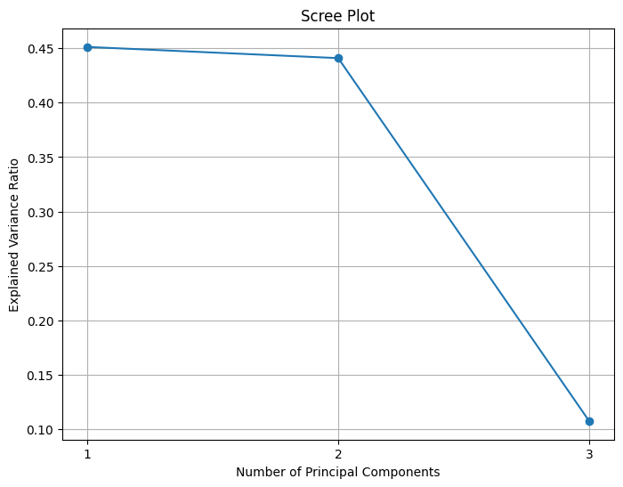
Scree Plot helps with selecting number of Principal Components
A scree plot displays the eigenvalues of each principal component in decreasing order, helping to visualize the amount of variance captured by each component. It aids in determining the optimal number of principal components to retain, as the "elbow" point where the eigenvalues sharply decrease indicates the cutoff for retaining significant variance while discarding noise or less informative components.

Slide 28
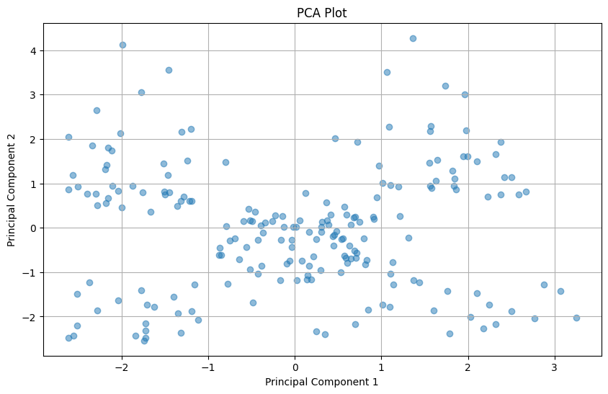
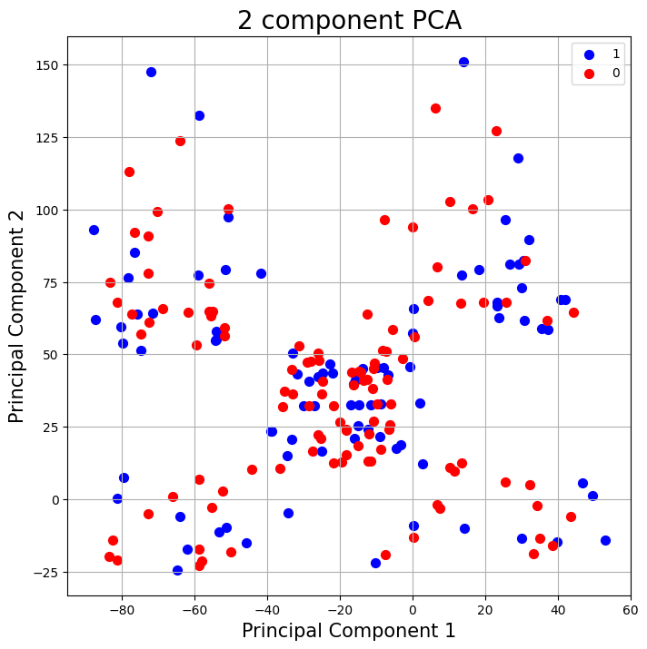
Principal Component Analysis Plot for Gender_Encoded

Slide 29
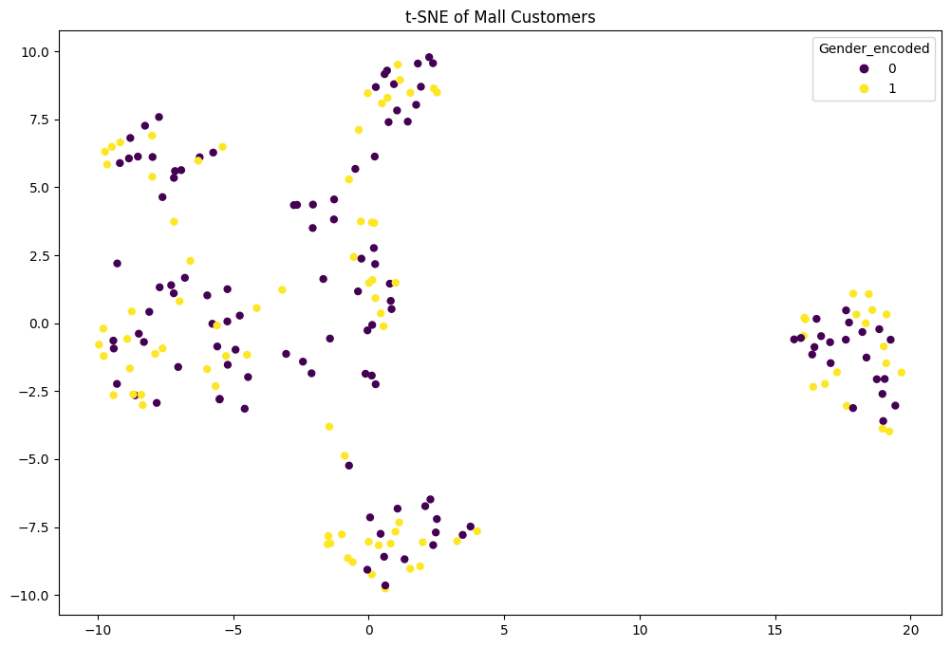
t-SNE of Mall Customers coloured by Gender_Encoded

Slide 30
LIME - Local Interpretable Model-agnostic Explanations
LIME is a widely used technique to explain the predictions of machine learning models. It offers a closer look at how a model generates predictions at the level of individual instances. LIME functions by estimating the predictions of a sophisticated model using a simpler, more understandable model in the vicinity of the instance under scrutiny. This approach allows LIME to pinpoint which features carry the most weight in the model's decision-making process for that specific instance. Such insights aid users in comprehending and having confidence in the decisions made by machine learning models, particularly in scenarios where the models are intricate and not easily interpretable.

Slide 31
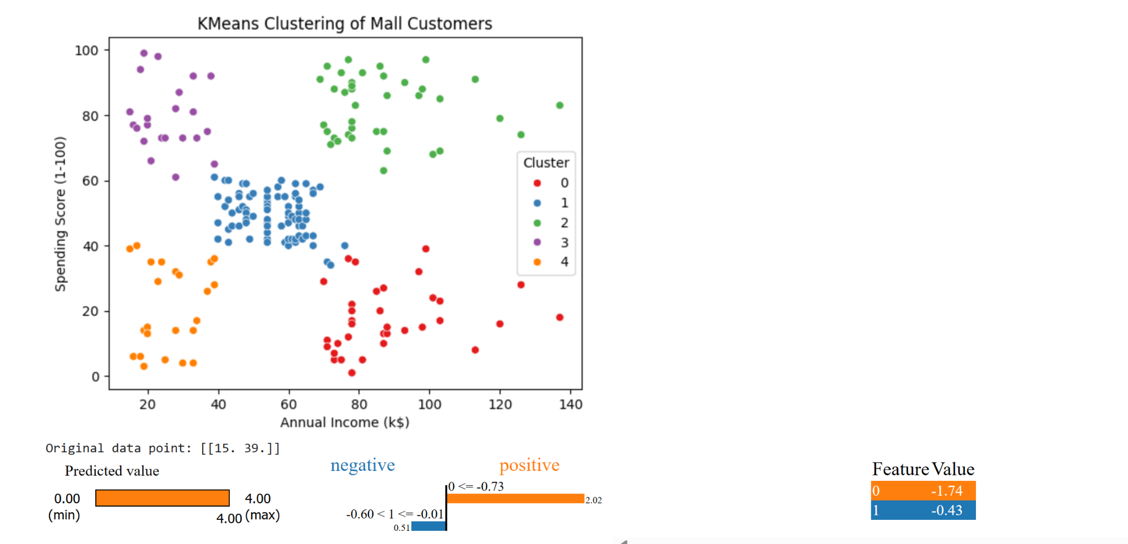
Explaining a data point using LIME
LIME explains individual predictions of machine learning models. For a customer with a low income and moderate spending score, LIME predicts they (customer) belong to cluster 4.
The model relies heavily on annual income for this prediction (Feature 0), while the spending score (Feature 1) has a lesser impact. This suggests that in this cluster, low income is a key factor.

Slide 32
THANK YOU

